Slide 1







Slide 2




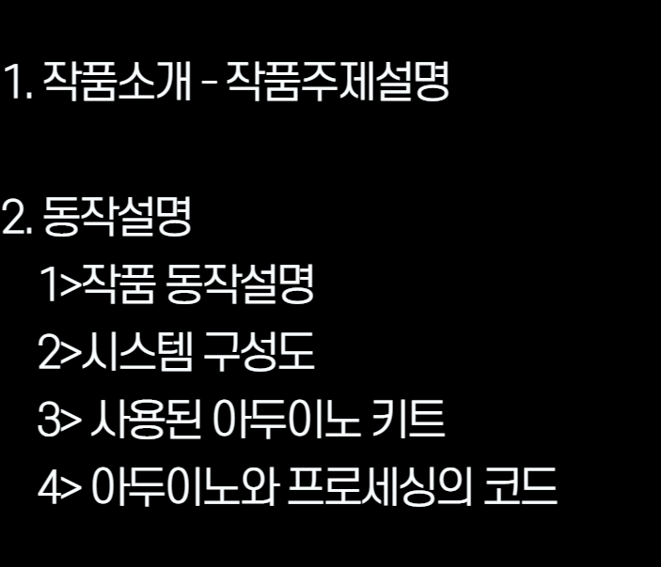



Slide 3
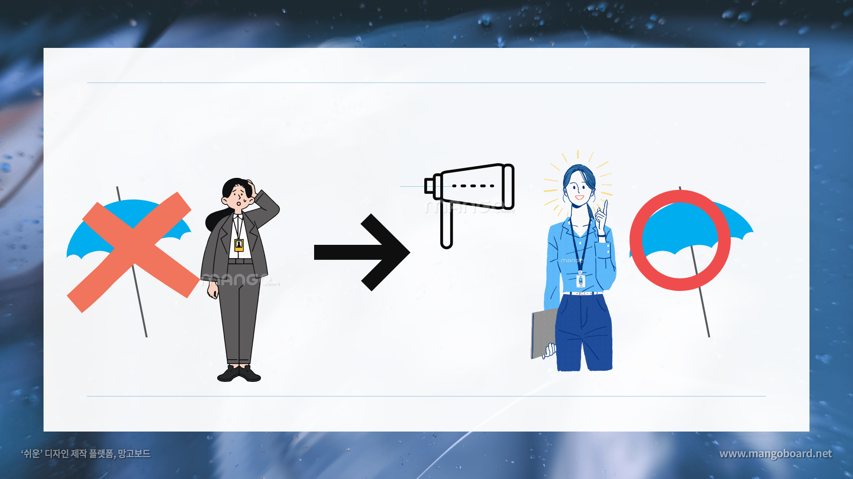




Slide 4

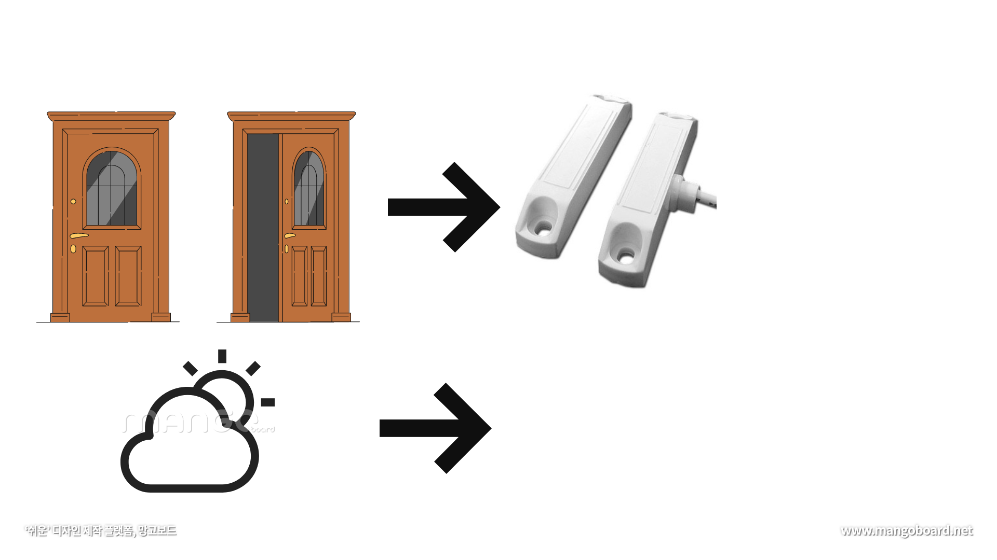



Slide 5
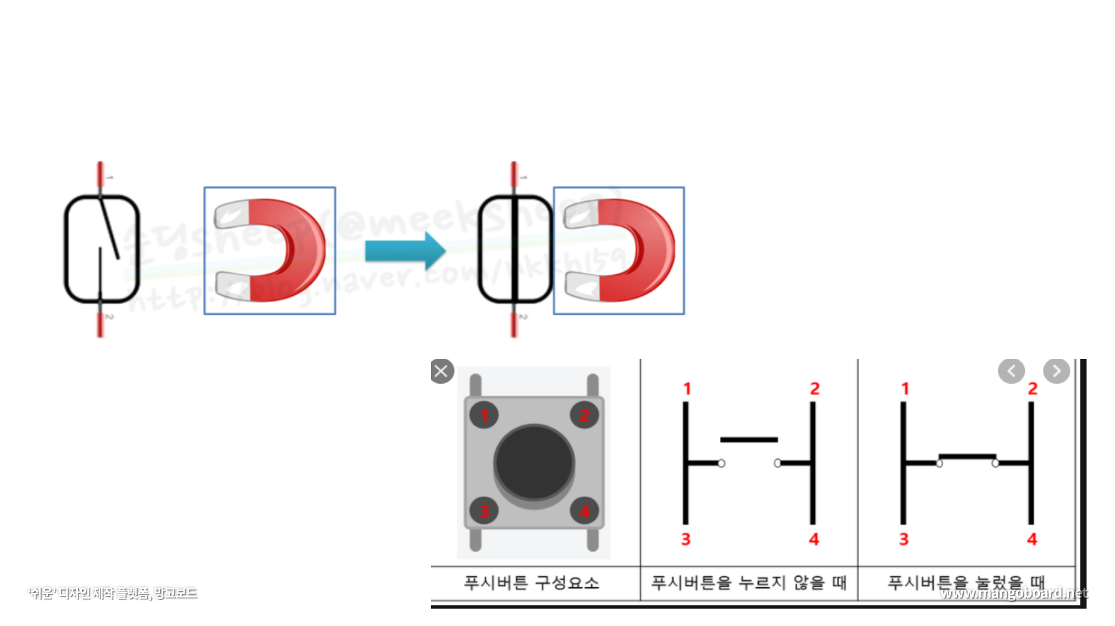


Slide 6
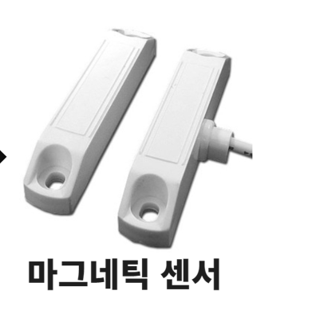
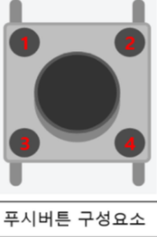
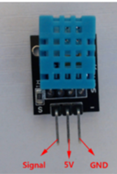
WIFI 모듈

Slide 7
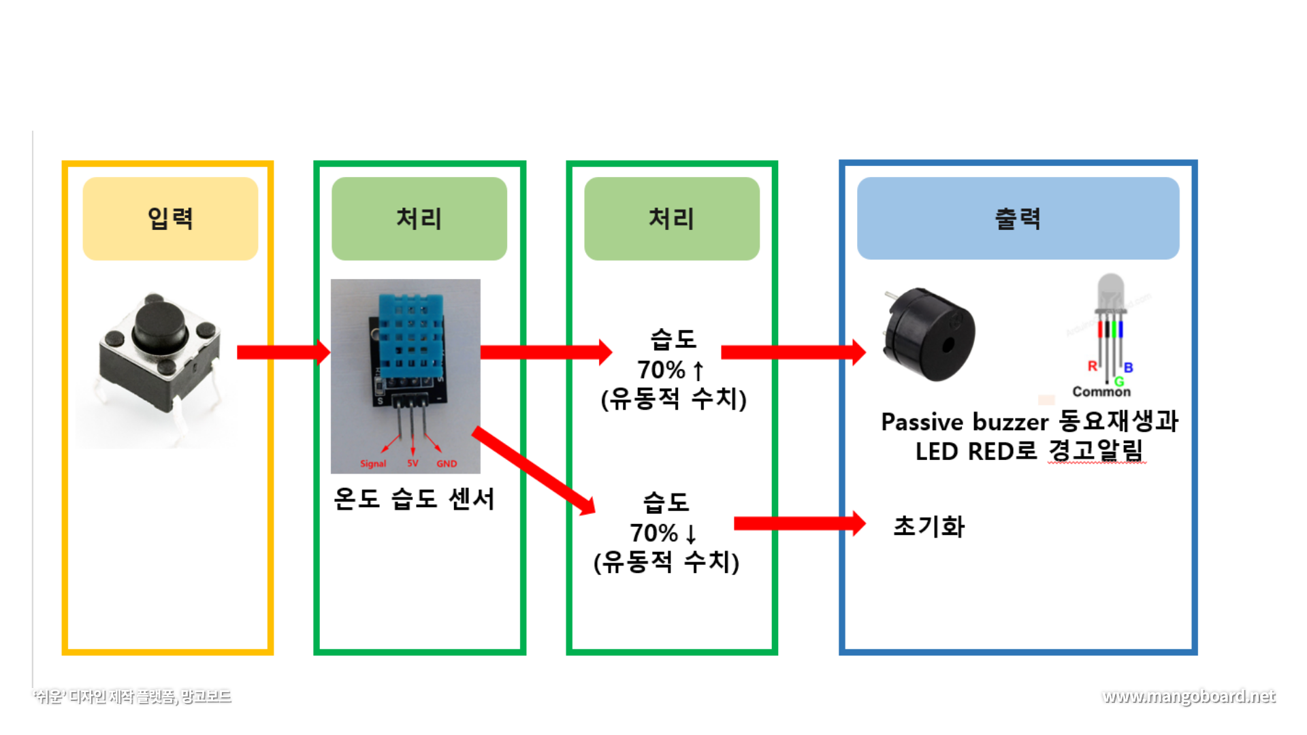


버튼 누르기

Slide 8
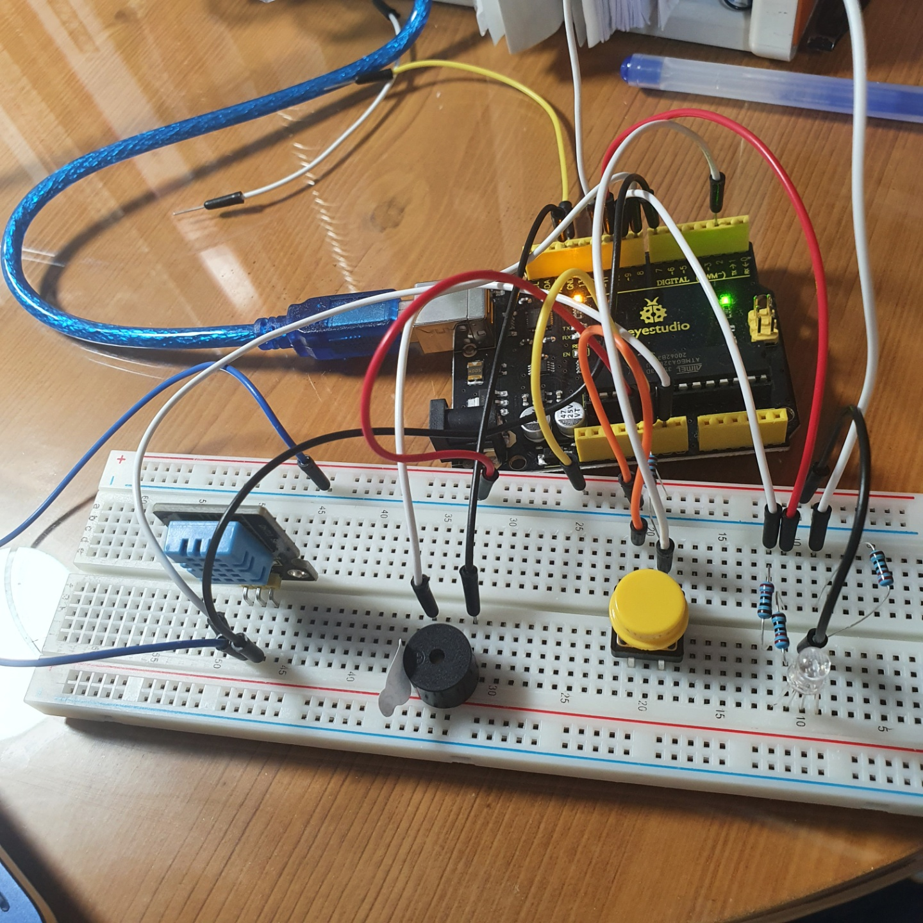

Slide 9
작품 동작 설명
아두이노 코드
#include <DHT.h>
#include <DHT_U.h>
#include <DHT.h>
#include <DHT_U.h>
#include <Adafruit_Sensor.h>
#include <DHT.h>
#include <DHT_U.h> //온습도
#define TRIG_PIN 3
#define ECHO_PIN 5
#define BUTTON 2
#define DHTPIN 7
#define DHTTYPE DHT11 // DHT 11
DHT_Unified dht(DHTPIN, DHTTYPE);
uint32_t delayMS = 1000;
int RedPin = 11;
int GreenPin = 10;
int BluePin = 9;
void setup() {
pinMode(TRIG_PIN, OUTPUT);
pinMode(ECHO_PIN, INPUT);
Serial.begin(9600); //시리얼모니터
//소리나는거
pinMode(8,OUTPUT);
Serial.begin(9600);
//습도
Serial.begin(9600);
// Initialize device.
dht.begin();
pinMode(BUTTON, INPUT);
//led
pinMode(RedPin,OUTPUT);
pinMode(GreenPin,OUTPUT);
pinMode(BluePin,OUTPUT);
}

Slide 10
작품 동작 설명
아두이노 코드
void loop() {
// Get humidity event and print its value.
sensors_event_t event; //_t는 user가 정의한 type
dht.humidity().getEvent(&event);
if(digitalRead(BUTTON)==HIGH){
if(event.relative_humidity > 70)
{
analogWrite(RedPin,255);
analogWrite(GreenPin,0);
analogWrite(BluePin,0);
tone(8,330,500); delay(500); //tone(8,262,지속시간);
tone(8,294,500); delay(500);
tone(8,262,500); delay(500);
tone(8,294,500); delay(500);
tone(8,330,500); delay(500);
tone(8,330,500); delay(500);
tone(8,330,500); delay(500);
tone(8,294,500); delay(500);
tone(8,294,500); delay(500);
tone(8,294,500); delay(500);
tone(8,330,500); delay(500);
tone(8,330,500); delay(500);
tone(8,330,500); delay(500);
tone(8,330,500); delay(500);
tone(8,294,500); delay(500);
tone(8,262,500); delay(500);
tone(8,294,500); delay(500);
tone(8,330,500); delay(500);
tone(8,330,500); delay(500);
tone(8,330,500); delay(500);
tone(8,294,500); delay(500);
tone(8,294,500); delay(500);
tone(8,330,500); delay(500);
tone(8,294,500); delay(500);
tone(8,262,500); delay(500);
digitalWrite(8, LOW);
}
}else
{
noTone(8);
digitalWrite(8, LOW);
}
digitalWrite(RedPin,LOW);
digitalWrite(GreenPin,LOW);
digitalWrite(BluePin,LOW);
}

